Slide 1
SUPER MARKET MANAGEMENT
GROUP :2
Feba Kurian
Anjali Sreekumar
Devika Nair
Irin George
Niya Francis

Slide 2
MODULES
ADMIN MODULE Add/ View Products Login/Register USER MODULE Login/Register Create Bill/ Transaction View Bill

Slide 3

HOME PAGE

Slide 4
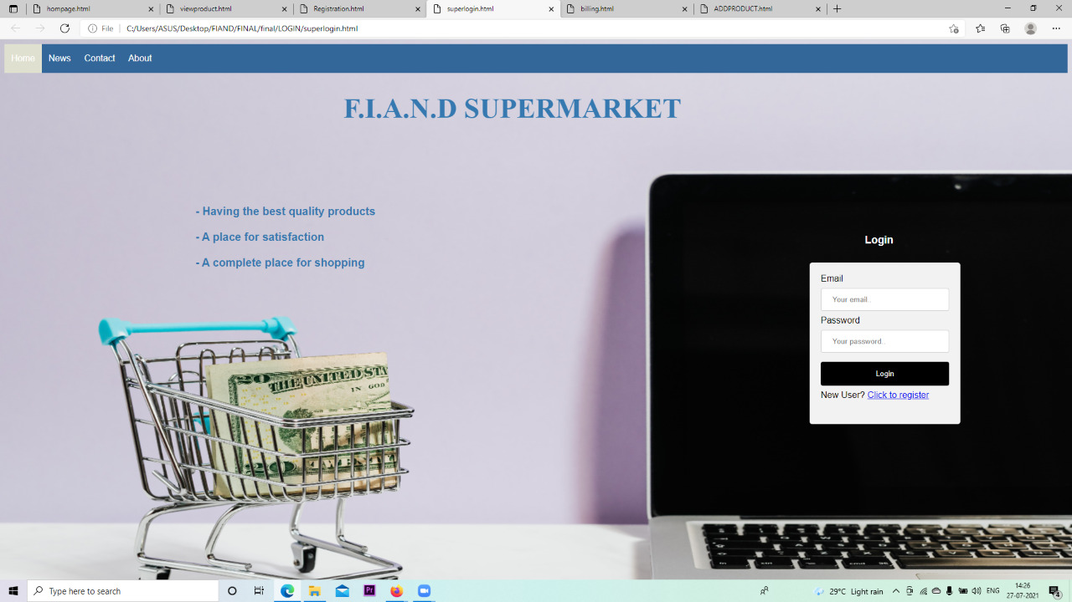

Slide 5
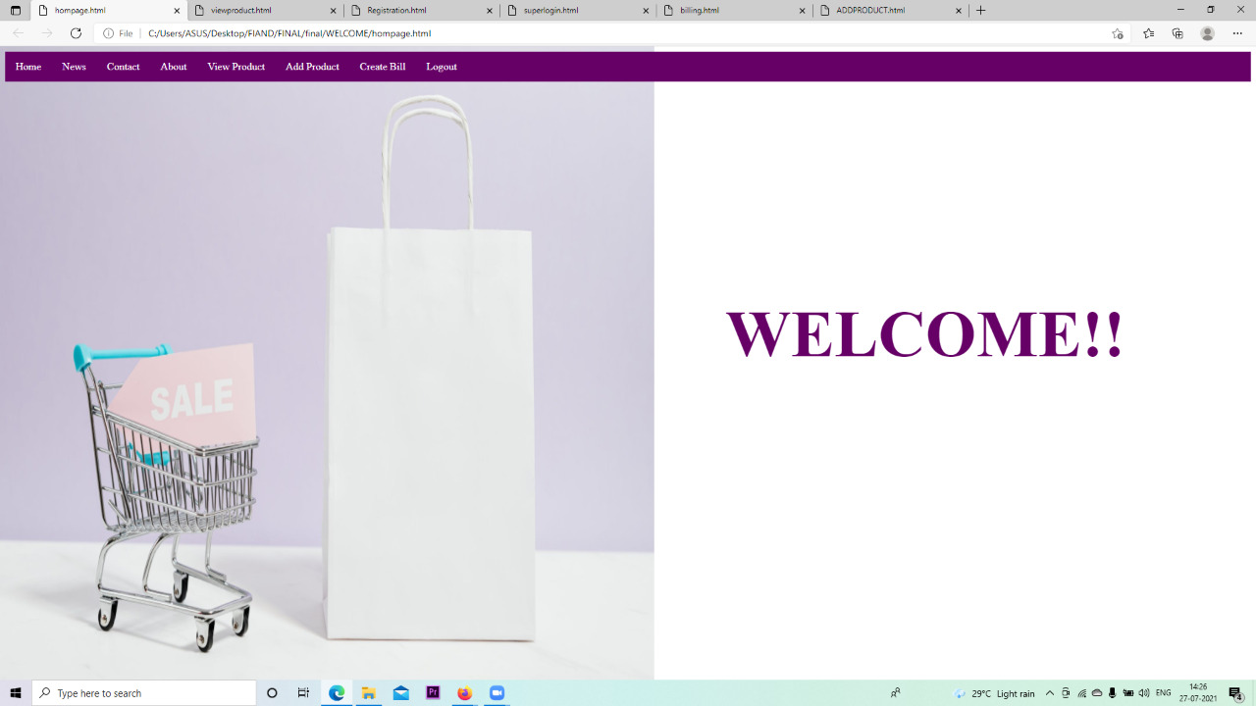

Slide 6

PROFILE CREATION

Slide 7
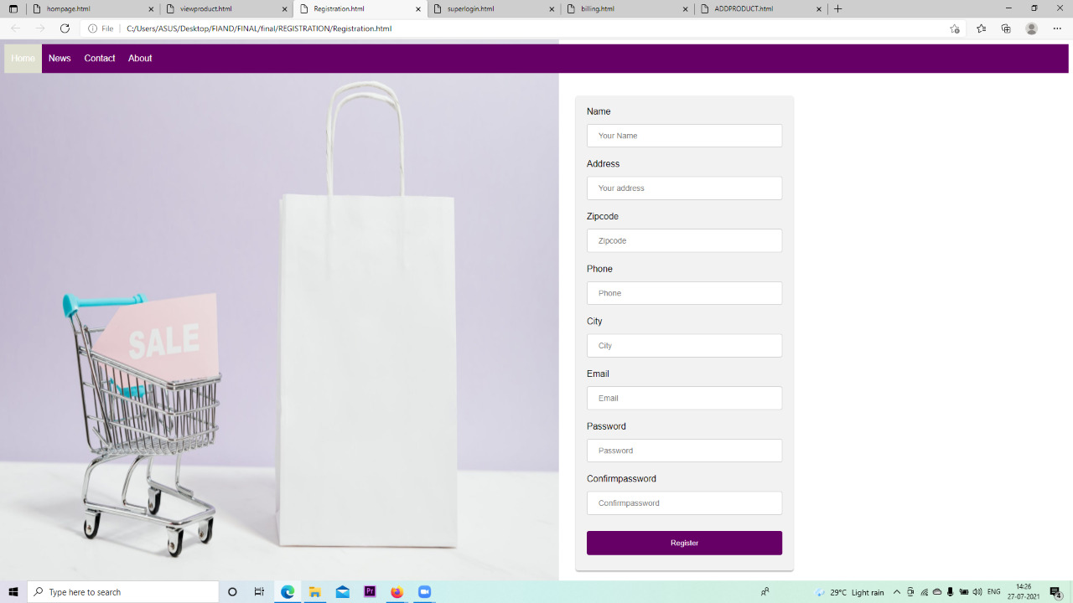

Slide 8




ADD PRODUCTS

Slide 9
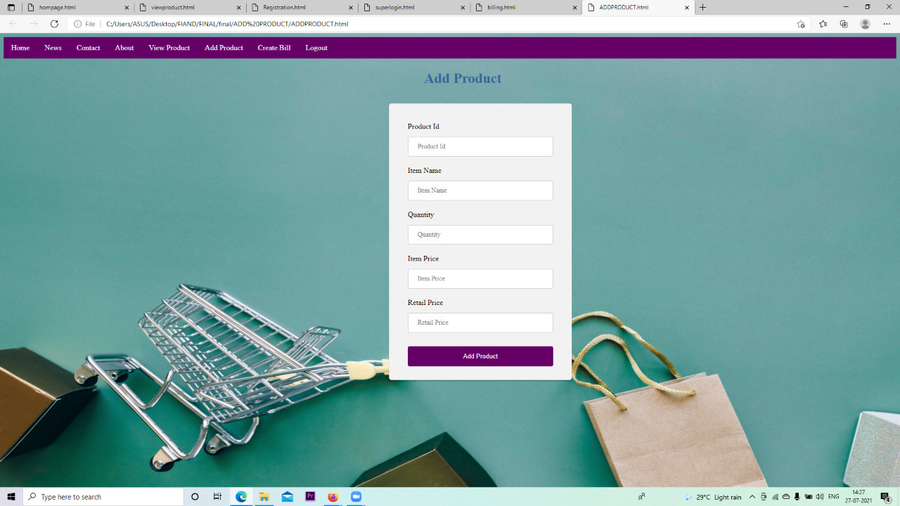

Slide 10

VIEW PRODUCT

Slide 11
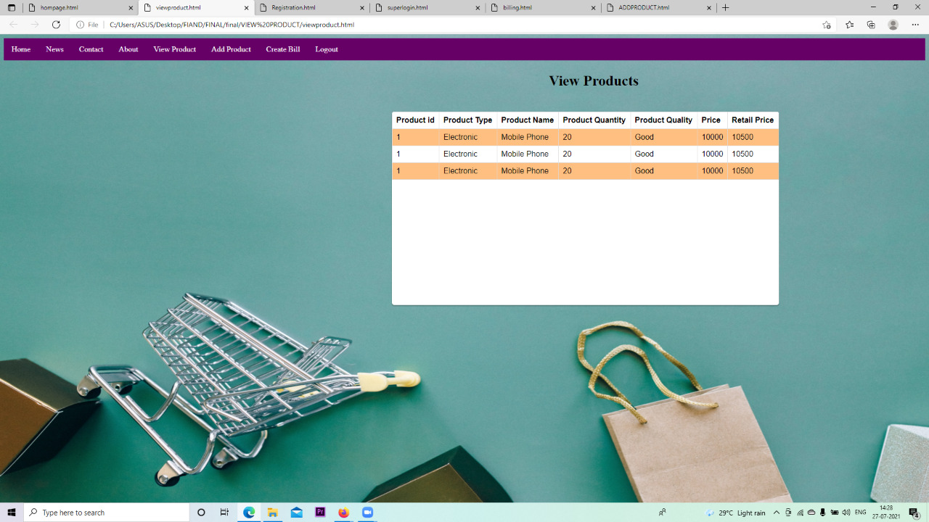

Slide 12




BILL CREATION

Slide 13
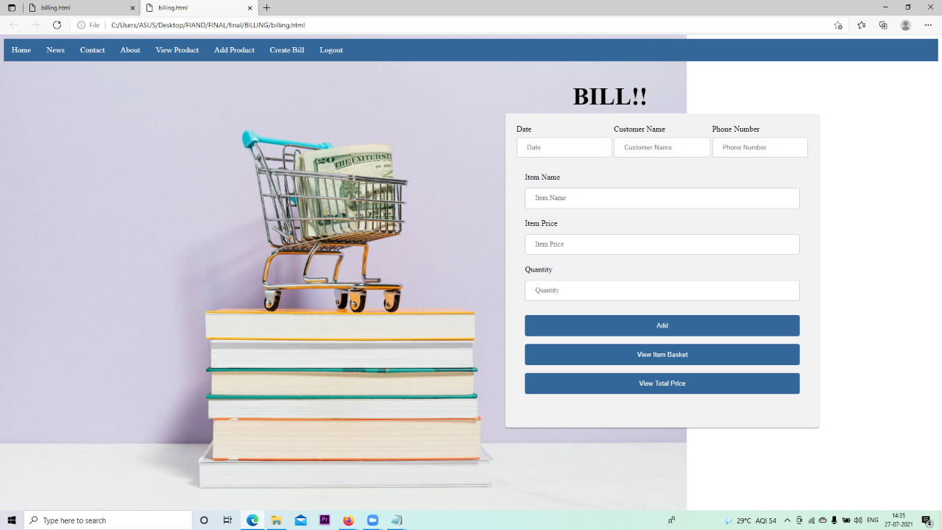

Slide 14
THANK YOU…

